Slide 1
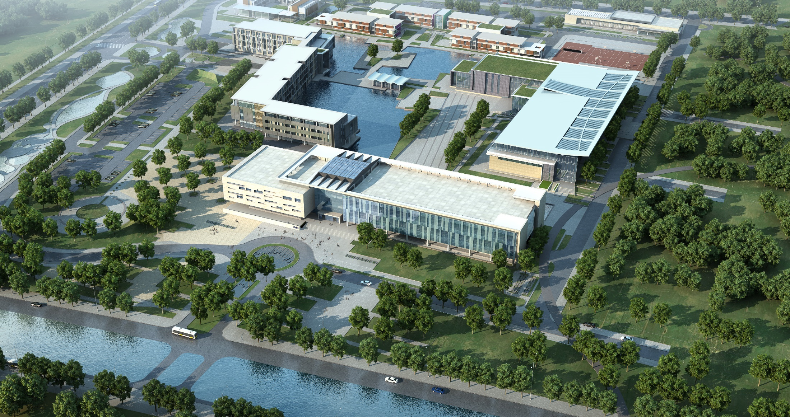
SLIC Superpixel Algorithm for Pixel Art
Yuchen Song
2024.12.10

Slide 2
Contents
1. Background and Motivation
2. Related Work
3. Methodology
4. Result and Analysis
5. Conclusion and Future Work

Slide 3
Background and Motivation

Slide 4
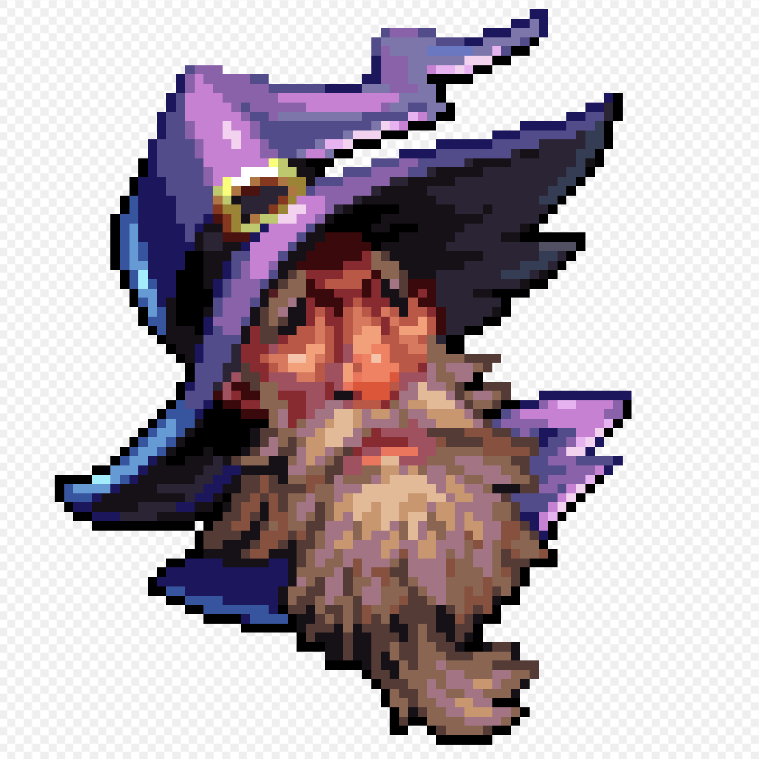
Introduction to Pixel Art
Pixel art is a digital art form that uses individual pixels as its primary building blocks.^{[1]}
Pixel art remains popular for its unique aesthetics, nostalgia, and capacity for storytelling through simplicity.
Figure 1^{[2]} is an example of pixel art anime figure.
Figure 1
[1] "Pixel Art." Wikipedia. Last modified November 27, 2024. https://en.wikipedia.org/wiki/Pixel_art.
[2] "Pixel Art." Wikipedia. Last modified November 27, 2024. https://en.wikipedia.org/wiki/Pixel_art.

Slide 5
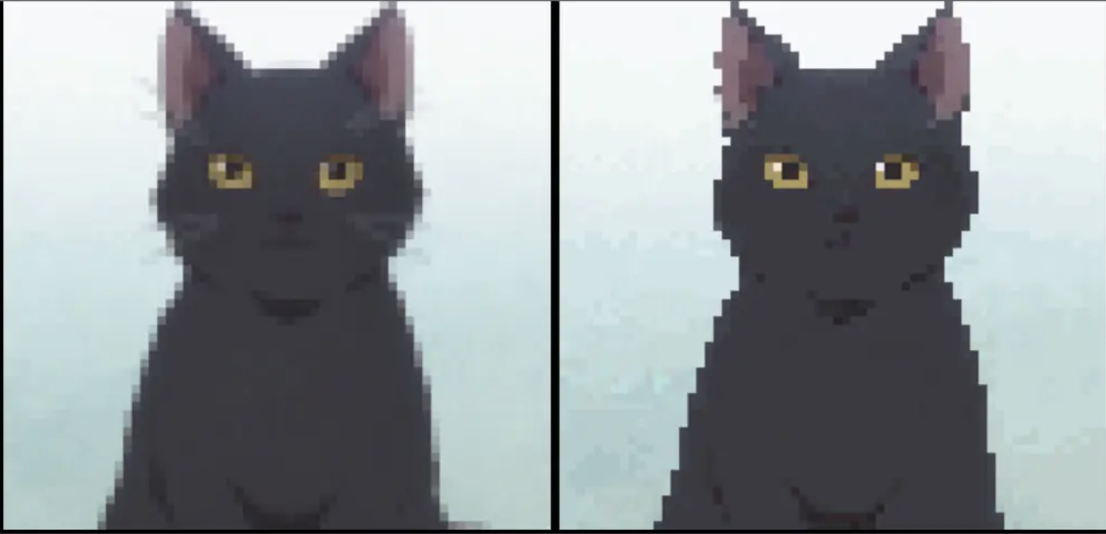
Features of Pixel Arts
Pixel art is distinct from simple digital effects like blur filters in several ways^{[1]}:
Deliberate Design
Sharpness and Detail
Color Palette Restrictions
Aesthetic Intent.
While blur filters have similar effects, pixel art is more artistic and need more specific method.
Figure 2
A contrast between mean filter (left) and pixel art processing (right)^{[2]}.
[1] "Pixel Art." Wikipedia. Last modified November 27, 2024. https://en.wikipedia.org/wiki/Pixel_art.
[2] "Pixel Art" Juejin. Last modified February 21, 2021. https://juejin.cn/post/7037122349048528927

Slide 6
Background on Creating Pixel Art
Currently, most pixel art creation methods are manual, relying heavily on the artist's expertise and a time-consuming process.
Each pixel must be deliberately placed and adjusted to achieve the desired composition, requiring not only a deep understanding of visual principles such as shading, color theory, and perspective but also a significant investment of time.

Slide 7
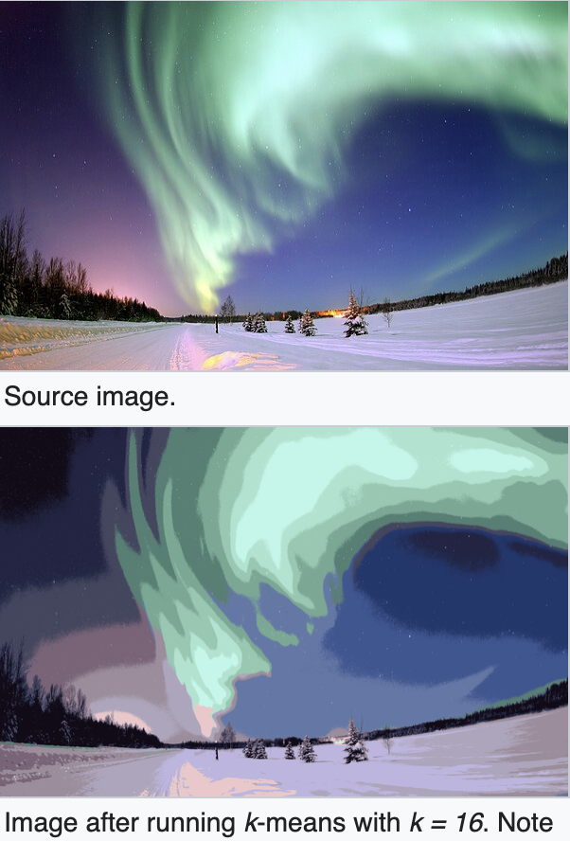
Background on Superpixel Algorithm
Superpixels Algorithms are a powerful tool in image segmentation, which aims to group pixels into meaningful atomic regions for efficient processing and analysis.
Figure 3 is a illustration of the implementation of Superpixel Algorithm on image.
Figure 3
[1] "Image Segmentation." Wikipedia, last modified November 27, 2024, https://en.wikipedia.org/wiki/Image_segmentation.

Slide 8
Motivation of this project
Since creating a pixel art is time consuming and requiring for the creator, my motivation is to create Pixel Art using digital image processing algorithms (Superpixel Algorithm) to reduce the time and aesthetic expertise in creating such art works.

Slide 9
Related Work

Slide 10
Superpixel generation
1. Mean Shift (MS02) ^{[3]}:
- Mode-seeking in feature space.
- No direct control over size or compactness.
2. Quick Shift (QS08)^{[4]}:
- Parzen density-based medoid shift.
- Computationally inefficient.
3. Watershed (WS91)^{[5]}:
- Simulates water flow from local minima.
- Irregular, noncompact regions.
Limitations: High computational costs. Irregular regions.
[3] D. Comaniciu and P. Meer, “Mean Shift: A Robust Approach toward Feature Space Analysis,” IEEE Trans. Pattern Analysis and Machine Intelligence, vol. 24, no. 5, pp. 603-619, May 2002.
[4] A. Vedaldi and S. Soatto, “Quick Shift and Kernel Methods for Mode Seeking,” Proc. European Conf. Computer Vision, 2008.
[5]L. Vincent and P. Soille, “Watersheds in Digital Spaces: An Efficient Algorithm Based on Immersion Simulations,” IEEE Trans. Pattern Analysis and Machine Intelligence, vol. 13, no. 6, pp. 583-598, June 1991.

Slide 11
Deep learning based Pixel Art Generation
1. Conditional GAN^{[6]}:
- Translates character images between poses.
- Streamlines sprite sheet creation for game development.
2. Pixel VQ-VAE^{[7]}:
- Learns discrete latent pixel art representations.
- Excels in embedding quality and downstream task performance.
3. DeepAI Pixel Art Generator^{[8]}:
- Converts images into pixel art using advanced algorithms.
- Accessible for non-expert users.
Limitation: Too complicated model. Require large training dataset.
[6] F. Coutinho and L. ''Chaimowicz, Generating pixel art character sprites using GANs,'' arXiv preprint arXiv:2208.06413, 2022.
[7] A.~Saravanan and M.~Guzdial, ``Pixel VQ-VAEs for improved pixel art representation,'' arXiv preprint arXiv:2203.1213}, 2022.
[8] DeepAI, ``Pixel Art Generator,'' DeepAI, 2024. [Online]. Available: https://deepai.org/machine-learning-model/pixel-art-generator. [Accessed: 10-Dec-2024].

Slide 12
Methodology

Slide 13
SLIC Algorithm
SLIC^{[9]} (Simple Linear Iterative Clustering) is an efficient and popular algorithm for generating superpixels. It groups pixels into perceptually meaningful regions while maintaining image boundaries and reducing data complexity.
Basic idea:
Similar to K-Means Clustering, it iterates the process:
(1) Assign each pixel to the nearest cluster center.
(2) Update the centroid.
[9] R. Achanta, A. Shaji, K. Smith, A. Lucchi, P. Fua, and S. Süsstrunk, "SLIC superpixels compared to state-of-the-art superpixel methods," IEEE Transactions on Pattern Analysis and Machine Intelligence, vol. 34, no. 11, pp. 2274-2282, Nov. 2012.

Slide 14
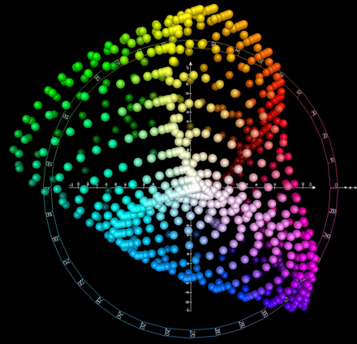
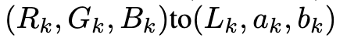
Color Space Transformation
Effect: Ensure perceptual uniformity and have better effect.
Measures: Converted input image from the RGB color space to the CIELAB (LAB)^{[9]} color space. You can
simply consider it as a transform of the
coordinates of the pixel value
from
Figure 4 is an example of the LAB space.
Figure 4
[9] "Colorimetry - Part 4: CIE 1976 Lab* Colour Space," International Commission on Illumination (CIE), Standard CIE S 014-4/E:2007, 2007.

Slide 15
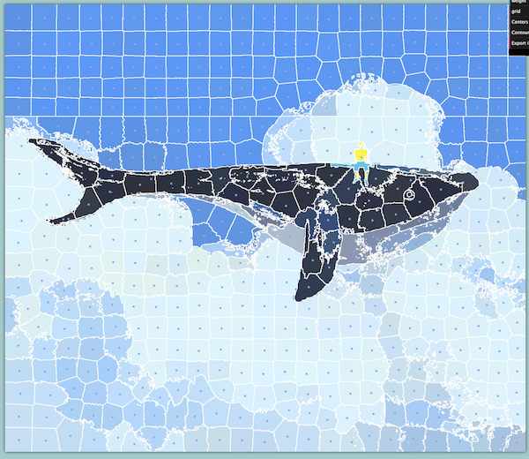
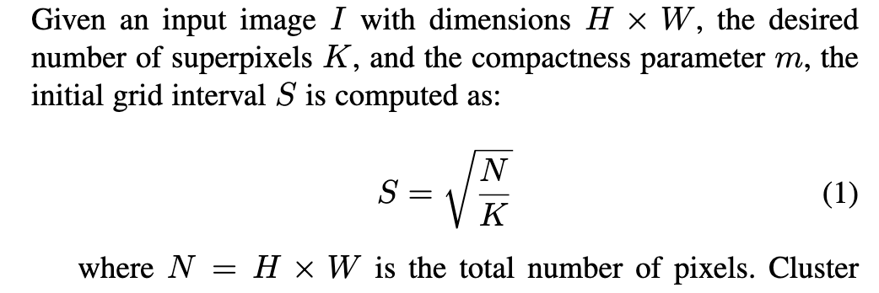

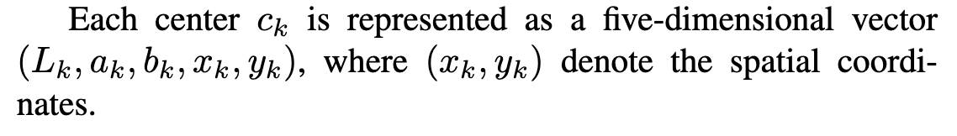
Initialization of Cluster Centers
Figure 5
Centroids Visualization^{[10]}
[10] "JD.com Jelly Article," JD.com, https://jelly.jd.com/article/60c88cad22bc900171d19fbd. Accessed: Dec. 11, 2024.

Slide 16
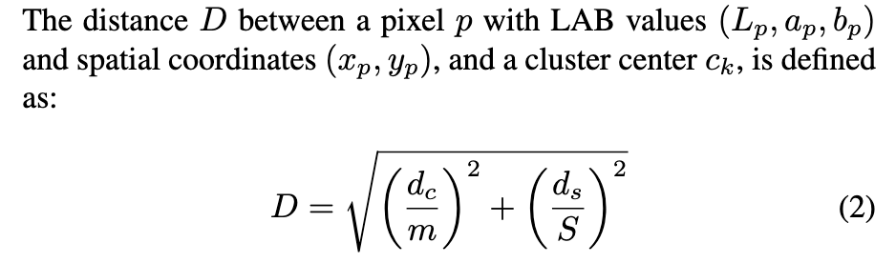
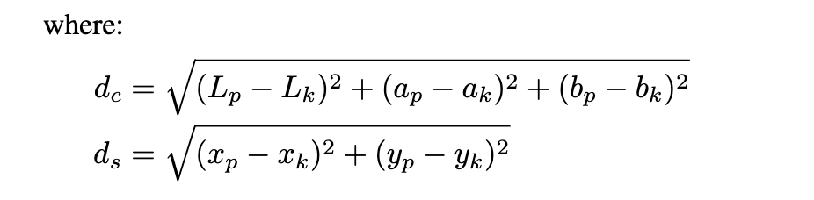
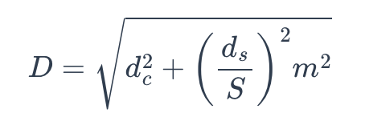
Distance Calculating
The SLIC distance D composed of:
(1) Color difference
(2) Euclidean distance difference
This is the way of calculating the distance^{[9]}.
[9] R. Achanta, A. Shaji, K. Smith, A. Lucchi, P. Fua, and S. Süsstrunk, "SLIC superpixels compared to state-of-the-art superpixel methods," IEEE Transactions on Pattern Analysis and Machine Intelligence, vol. 34, no. 11, pp. 2274-2282, Nov. 2012.

Slide 17
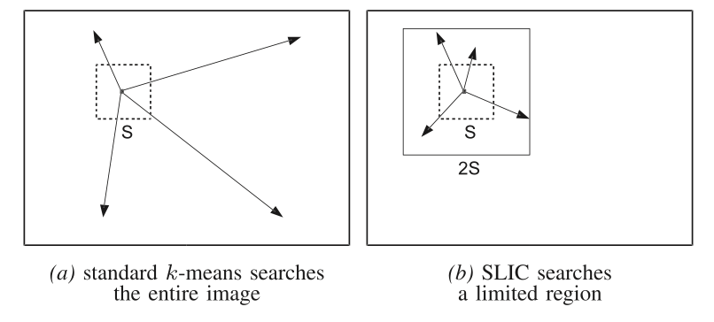
Iterative Clustering and Connectivity
Iterative Clustering: (A process where pixel assignments to clusters are refined over multiple iterations)
Place cluster centers evenly across the image grid.
Assign pixels to the nearest cluster based on a combined distance metric.
Update cluster centers using the mean position and color of assigned pixels.
Reassign pixels based on the updated cluster centers.
Figure 7 (a, b) ^{[9]} shows the difference between k-means update and SLIC update.
Figure 7
[9] R. Achanta, A. Shaji, K. Smith, A. Lucchi, P. Fua, and S. Süsstrunk, "SLIC superpixels compared to state-of-the-art superpixel methods," IEEE Transactions on Pattern Analysis and Machine Intelligence, vol. 34, no. 11, pp. 2274-2282, Nov. 2012.

Slide 18
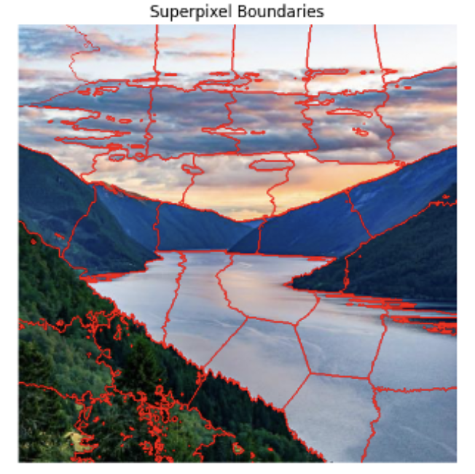
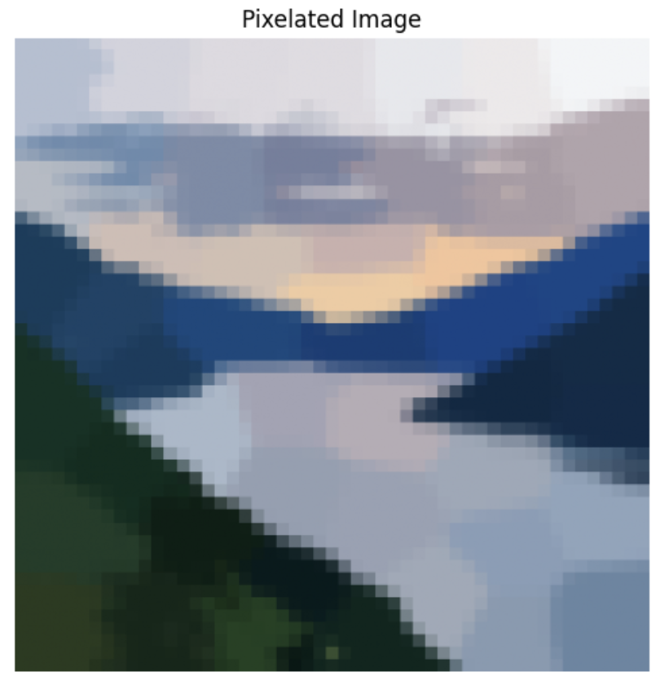
Post-Processing for Pixel Art
Enforce connectivity
Assignment superpixel color with average color
Fill superpixel block with assigned color
Figure 6 (1) is a example of the final superpixel boundary visualization.
Figure 7 is the pixel art after assigned average color of each block.
Figure 7.1
Figure 7.2

Slide 19
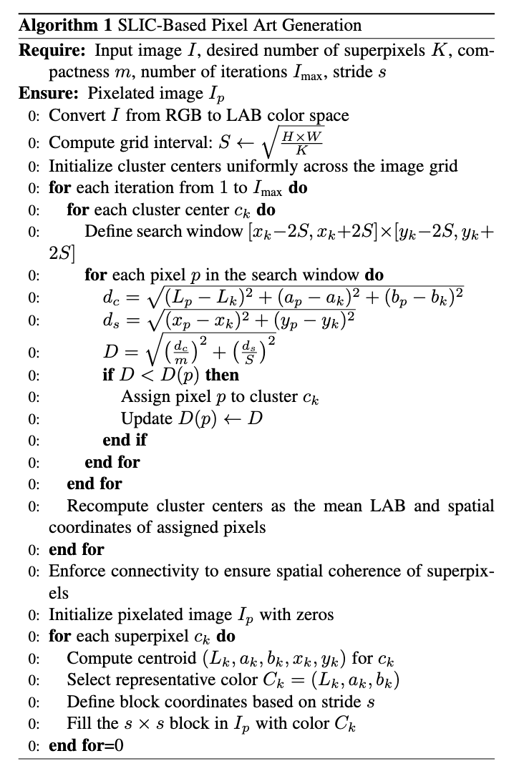
Pseudocode Implementation

Slide 20
Results and Analysis

Slide 21
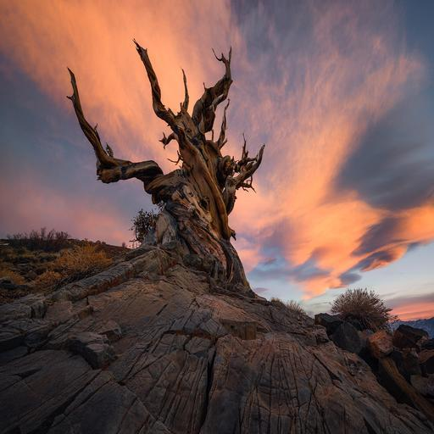
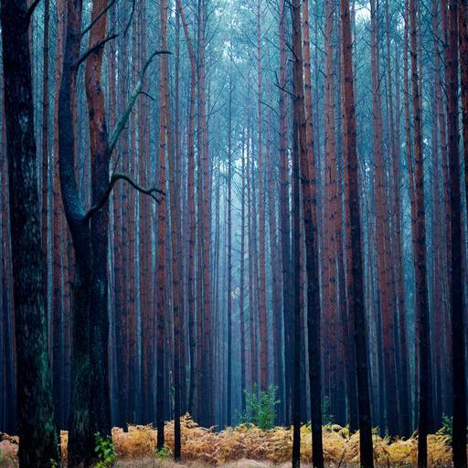

Dataset
The dataset used is a subset from Scenery Watermarks Dataset^{[11]} from Hugging Face. Images are 512*512 in size and with content of sceneries.
Figure 8, 9, 10 are images from dataset^{[11]}.
Figure 8
Figure 9
Figure 10
[11] Qwertyforce, "Scenery Watermarks Dataset," Hugging Face, 2024. [Online]. Available: https://huggingface.co/datasets/qwertyforce/scenery_watermarks. [Accessed: 11-Dec-2024].

Slide 22
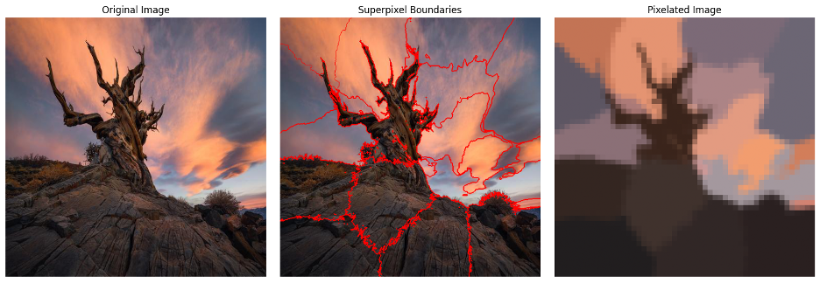
Result
This report primarily focuses on qualitative assessments due to scope constraints. Figure 11 is an example of the final effect of
SLIC implementation and post pixelize processing.
Figure 11

Slide 23
Comparison on parameter:
To evaluate the performance of the SLIC algorithm, experiments were conducted on various images with different parameters, such as
Number of Superpixels (k)
Compactness Parameter (m)
Pixel Scale

Slide 24
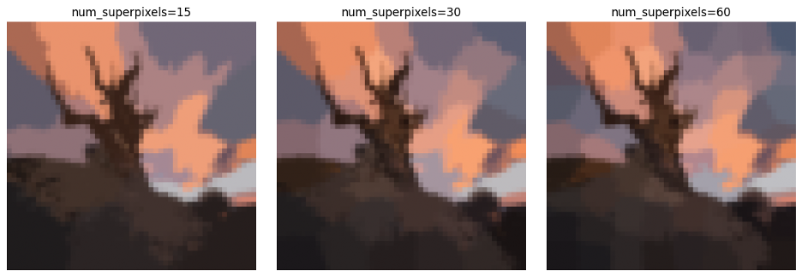
Number of Superpixels
The number of superpixels determines the segmentation granularity.
The smaller the number is, the less detail is kept of the original image.
Figure 12

Slide 25
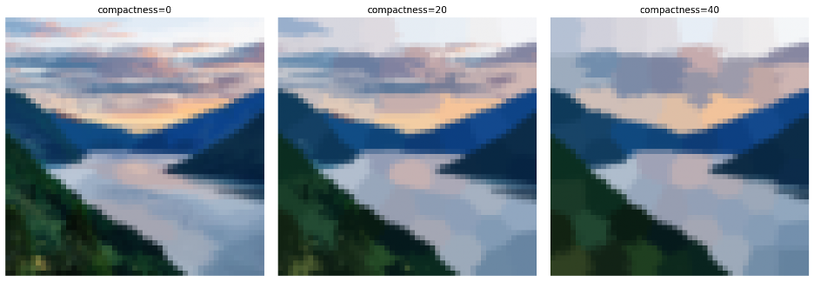
Compactness Parameter
According to paper^{[9]}, compactness controls the balance between color similarity and spatial proximity.
The smaller compactness is, the more smoother the transfer between the superpixels.
Figure 13
[9] R. Achanta, A. Shaji, K. Smith, A. Lucchi, P. Fua, and S. Süsstrunk, "SLIC superpixels compared to state-of-the-art superpixel methods," IEEE Transactions on Pattern Analysis and Machine Intelligence, vol. 34, no. 11, pp. 2274-2282, Nov. 2012.

Slide 26
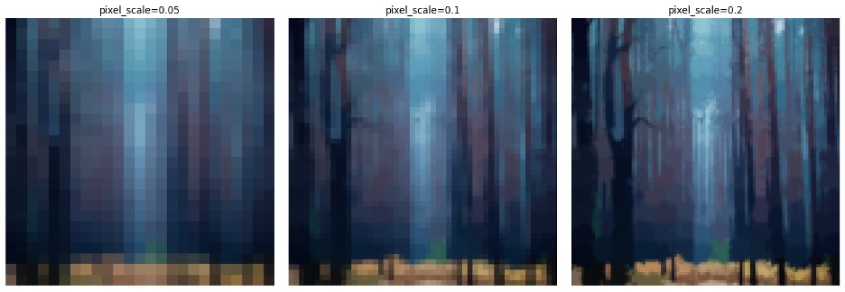
Pixel Scale
Pixel scale is the size of the unit pixel value of the superpixel.
Finer pixel scales enhance boundary precision but demand higher computational resources.
Figure 14

Slide 27
Conclusion and Future Work

Slide 28
Conclusion
SLIC Algorithm Performance:
Increasing superpixel number improves segmentation detail.
Higher compactness produces regular superpixel shapes, whereas lower adheres better to boundaries.
Finer pixel scales enhance boundary precision but demand higher computational resources.

Slide 29
Future Work
Develop adaptive mechanisms to automatically tune the parameters based on image characteristics, ensuring optimal performance across diverse datasets, not limiting to scenery.
Use a more quantitative method to evaluate the art effect of the generated pixel art rather than applying only qualitative comments.

Slide 30
Thank you!

Slide 31
References:
[1] "Pixel Art." Wikipedia. Last modified November 27, 2024. https://en.wikipedia.org/wiki/Pixel_art.
[2] "Pixel Art" Juejin. Last modified February 21, 2021. https://juejin.cn/post/7037122349048528927
[3] D. Comaniciu and P. Meer, “Mean Shift: A Robust Approach toward Feature Space Analysis,” IEEE Trans. Pattern Analysis and Machine Intelligence, vol. 24, no. 5, pp. 603-619, May 2002.
[4] A. Vedaldi and S. Soatto, “Quick Shift and Kernel Methods for Mode Seeking,” Proc. European Conf. Computer Vision, 2008.
[5]L. Vincent and P. Soille, “Watersheds in Digital Spaces: An Efficient Algorithm Based on Immersion Simulations,” IEEE Trans. Pattern Analysis and Machine Intelligence, vol. 13, no. 6, pp. 583-598, June 1991.
[6] F. Coutinho and L. ''Chaimowicz, Generating pixel art character sprites using GANs,'' arXiv preprint arXiv:2208.06413, 2022.
[7] A.~Saravanan and M.~Guzdial, ``Pixel VQ-VAEs for improved pixel art representation,'' arXiv preprint arXiv:2203.1213}, 2022.
[8] DeepAI, ``Pixel Art Generator,'' DeepAI, 2024. [Online]. Available: https://deepai.org/machine-learning-model/pixel-art-generator. [Accessed: 10-Dec-2024].
[9] R. Achanta, A. Shaji, K. Smith, A. Lucchi, P. Fua, and S. Süsstrunk, "SLIC superpixels compared to state-of-the-art superpixel methods," IEEE Transactions on Pattern Analysis and Machine Intelligence, vol. 34, no. 11, pp. 2274-2282, Nov. 2012.
[10] "JD.com Jelly Article," JD.com, https://jelly.jd.com/article/60c88cad22bc900171d19fbd. Accessed: Dec. 11, 2024.
[11] Qwertyforce, "Scenery Watermarks Dataset," Hugging Face, 2024. [Online]. Available: https://huggingface.co/datasets/qwertyforce/scenery_watermarks. [Accessed: 11-Dec-2024].

